Slide 1
Django To – Do App
BY TEAM TRAILBLAZERS:
MANJIMA BHATTACHARYYA
ANOUSHKA DAS

Slide 2
INDEX
Problem Statement
Project Overview
Who are the end users?
Your solution and its value proposition
The ‘Wow’ in our Solution
Modelling
Result

Slide 3
Problem Statement
It is true that getting organized and using a daily planner won’t solve all of our problems, but it will make juggling them a little easier.
Especially, when our screen time is high, having a digital or an on-screen planner makes it convenient and effective for individuals to use.

Slide 4
Project Overview
There are a lot of reasons why having a daily planner is beneficial. The most important reason that you should have one is that it helps keep track of records of your daily activities. This includes homework, chores, appointments, and meetings.
It's easy to keep track of things while you're running errands, going to a meeting, or attending a class.
Django is a high-level Python Web framework-based web framework that allows rapid development and clean, pragmatic design.

Slide 5
Who are the end users?
For all individual users
Especially for students and working employees.

Slide 6
Solution & its Value Proposition
Having a daily planner is also essential for people who are always on the go. It's easy to keep track of things while you're running errands, going to a meeting, or attending a class.
You can always pull out your planner and take a quick look when you're in a rush to make sure that you don't forget any important things.
This will not only save time but also ensure increased productivity.

Slide 7
The ‘Wow’ in our Solution
The Planner Is Customizable -With a digital planner file you can change the layout of the document, move pages up and down, delete or duplicate elements, add new elements. Having a customizable document means that you can make it to suit your needs instead of having to adapt your planner style to the available layout in a paper planner.
It Saves Your Time - Using a digital planner, you can be more efficient by coping tasks and appointments, dragging and dropping items, duplicate pages or erasing items with a click of a button. You can also write freely and later go back to edit color and position of the information written in the page. Working as a batching system will always be more productive.

Slide 8
The ‘Wow’ in our Solution
Digital Planners Help Reduce Waste - So digital planners are more environmentally friendly than traditional planners because you have less clutter and you produce less waste.
A Digital Planner Is Accessible Everywhere - With a digital planner you can access your notes and task from everywhere as it’s possible to sync with a variety of devices. No matter if you forgot your paper planner at home.

Slide 9
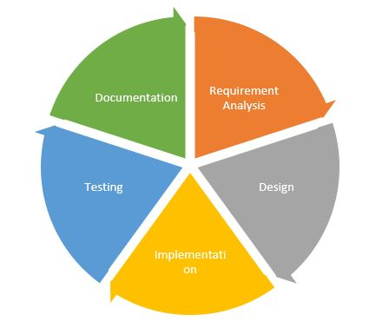
Modelling

Slide 10
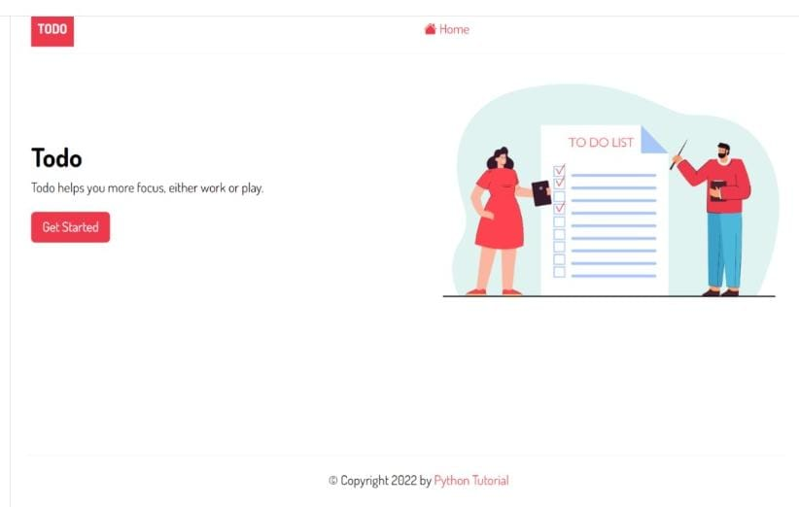
Result

Slide 11
Thank You

